Slide 1
WICCI DIVERSITY & INCLUSION COUNCIL(DAIC)
WOMEN´S INDIAN CHAMBER OF COMMERCE AND INDUSTRY
www.wicci.in

Slide 2
Council Vision &Mission
This council is a heady and harmonious group of Tri Services wives ,daughters ,sisters ,aunts and friends . We aim to work and synergize all our efforts to empower women beyond just words and provide an equal inclusive platform for some meaningful work for diverse segments of the society.

Slide 3
Welcoming
Council Members to
WICCI
President, Vice President
and 20+ Nominated Council Members

Slide 4
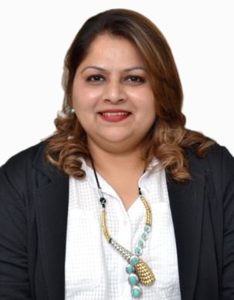
NAVNEET GREWAL , STATE PRESIDENT Chandigarh UT Diversity & Inclusion Council
BIO :- Navneet Grewal is a published author ,language teacher and aspiring internationally certified soft skills trainer. Having travelled extensively in India and Abroad she loves to study the cultural diversity and diaspora of language use. She conducts training workshops in three dimensions of mental health , correct language use and soft skills as an imperative part of one’s overall personality.
Insert High Resolution Picture

Slide 5
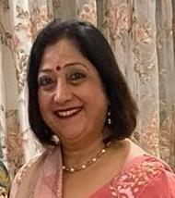
BINDU BAJWA GILL VICE PRESIDENT
Chandigarh UT Diversity & Inclusion Council
BIO :- A passionate kindergarten teacher she has worked diligently with specially abled children of the ASHA school in a cantonment. She loves to bake and travel and is very keen to support social causes related to young girls and the elderly.
Insert High Resolution Picture

Slide 6
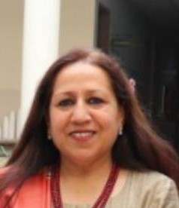
MANINDER PAMA , VICE PRESIDENT Chandigarh UT Diversity & Inclusion Council
BIO :- A qualified Social studies and Language teacher she loves to train and guide teams through a specialized curriculum induced learning .
Has consulted on a number of educational projects and initiated a conditioned and fruitful use of activity based learning.
Insert High Resolution Picture

Slide 7
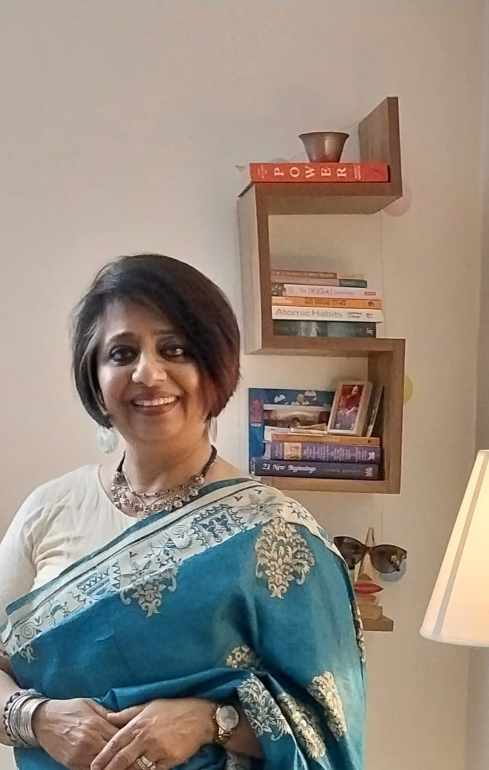
ANINDER MANN , MEMBER Chandigarh UT Diversity & Inclusion Council
BIO :- A theatre artist ,specialized early childhood care and education facilitator she is an excellent orator. With a teaching experience spanning a decade she has head a school in the principal’s capacity.
Insert High Resolution Picture

Slide 8
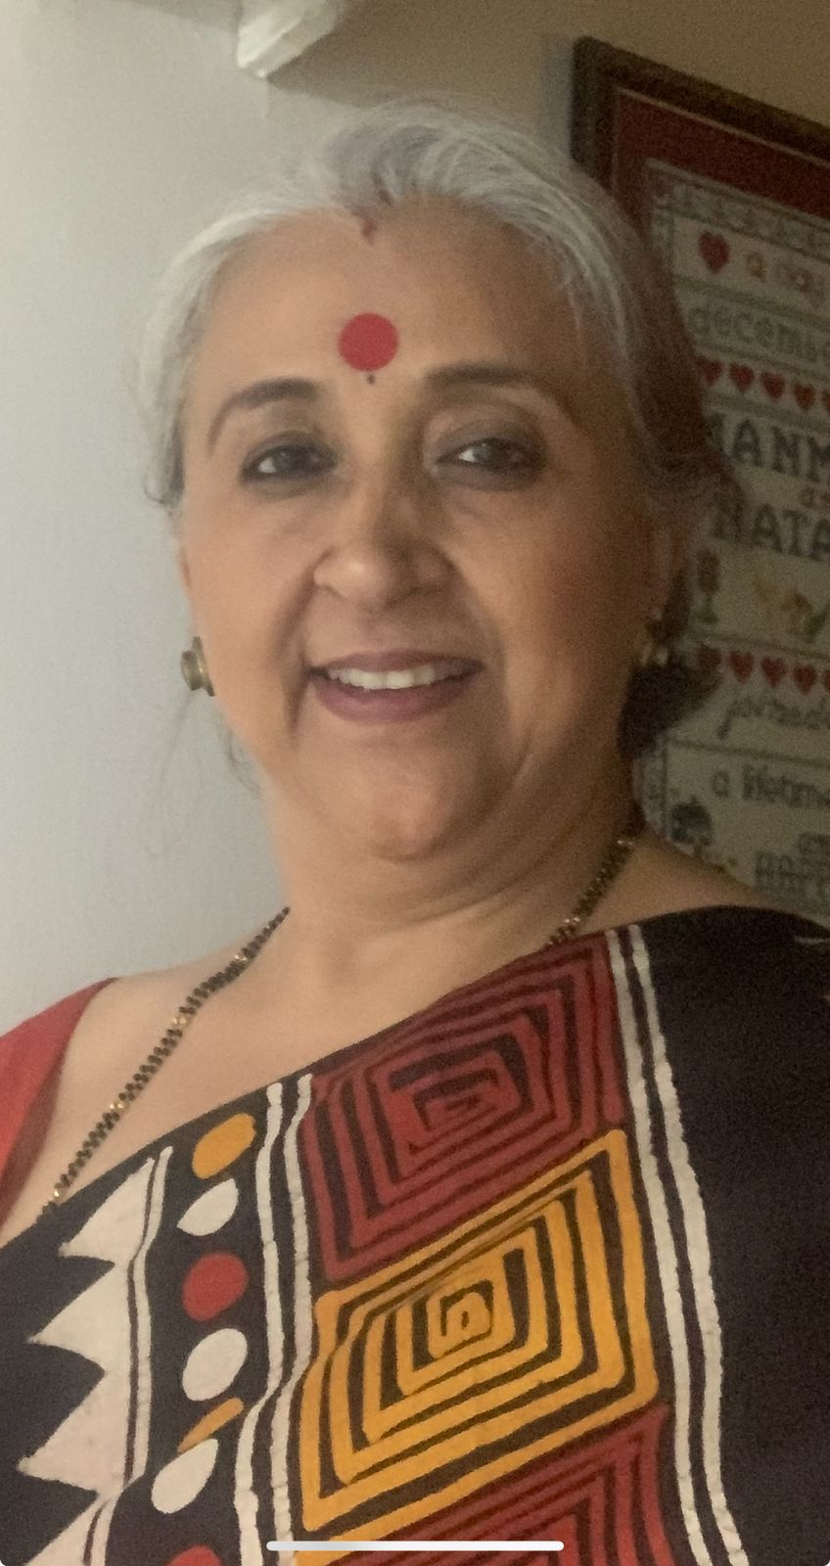
DAMANJYOT VIRDI ,MEMBER Chandigarh UT Diversity & Inclusion Council
BIO :- An educationist and former principal she is a qualified mass communication and journalism graduate. Who loves to travel and explore different cultures and cuisines.
Insert High Resolution Picture

Slide 9
PREETI SEKHON , MEMBER Chandigarh UT Diversity & Inclusion Council
BIO :- A passionate and dedicated kindergarten teacher she is an avid nature lover. Her other interests include reading up current affairs and keeping herself abreast of changing trends .
Insert High Resolution Picture

Slide 10
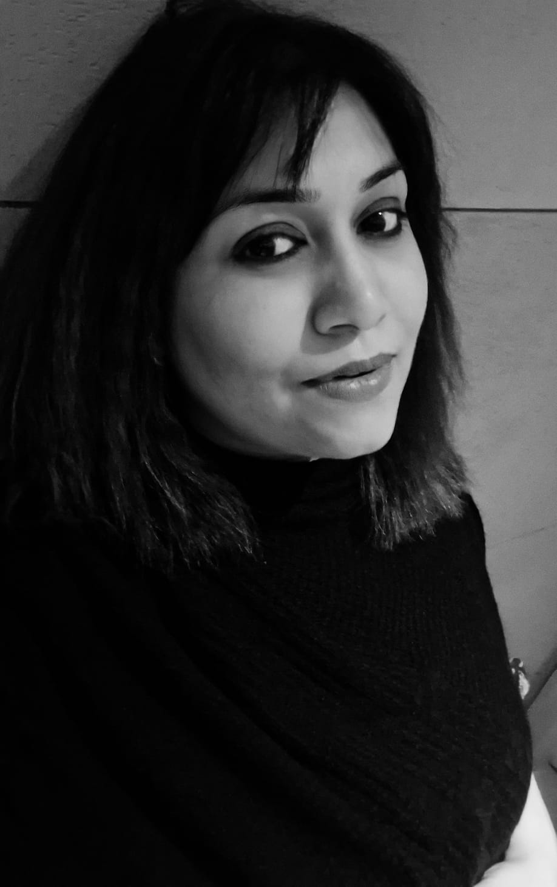
GOWRI BHARDWAJ , MEMBER Chandigarh UT Diversity & Inclusion Council
BIO :- A Doctorate in Journalism and Mass Communication she has over 12 years of rich experience in the industry and academia. Providing dynamic insights into the media landscape she has a liking for art and is currently pursuing an soft skills & image management course.
Insert High Resolution Picture

Slide 11
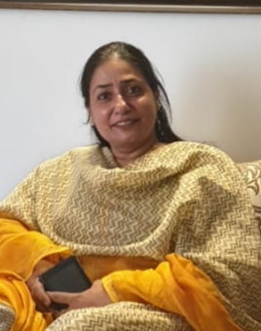
SUDEEP KAUR ,MEMBER Chandigarh UT Diversity & Inclusion Council
BIO :- A sincere science teacher she is fond of travelling. For almost two decades has been passionately customizing commissioned relief art on name plates ,mirrors ,paintings ,murals etc.
Insert High Resolution Picture

Slide 12
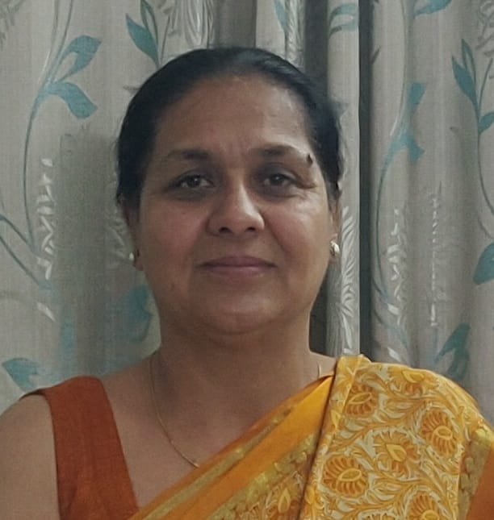
RETINDERJIT DHILLON ,MEMBER Chandigarh UT Diversity & Inclusion Council
BIO :- A passionate educator who is currently also taking classes for the underprivileged at her home she loves to explore watercolor paintings and varied art mediums
Insert High Resolution Picture

Slide 13
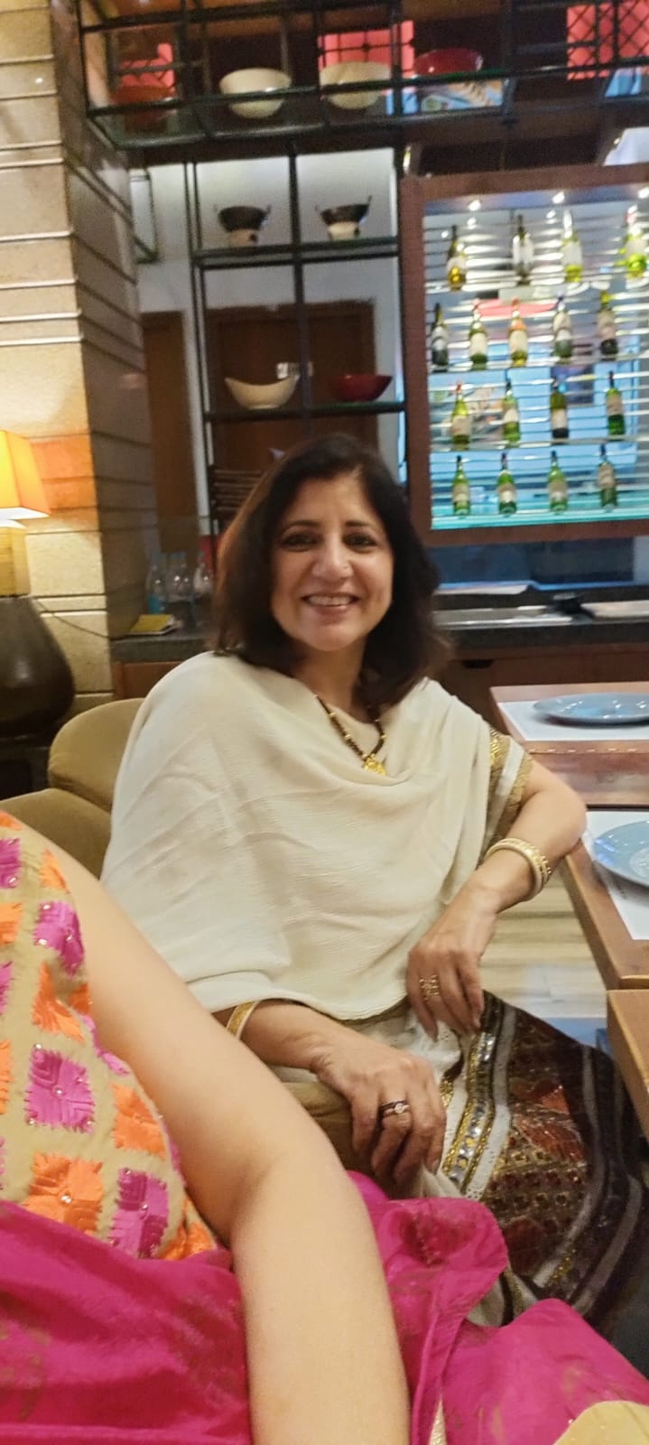
ANUJA MALIK NANDA , MEMBER Chandigarh UT Diversity & Inclusion Council
BIO :- Having done her masters in Clothing & Textiles she has worked as a lecturer too. Currently she is pursuing her passion for textile art and designing from her home studio.
Insert High Resolution Picture

Slide 14
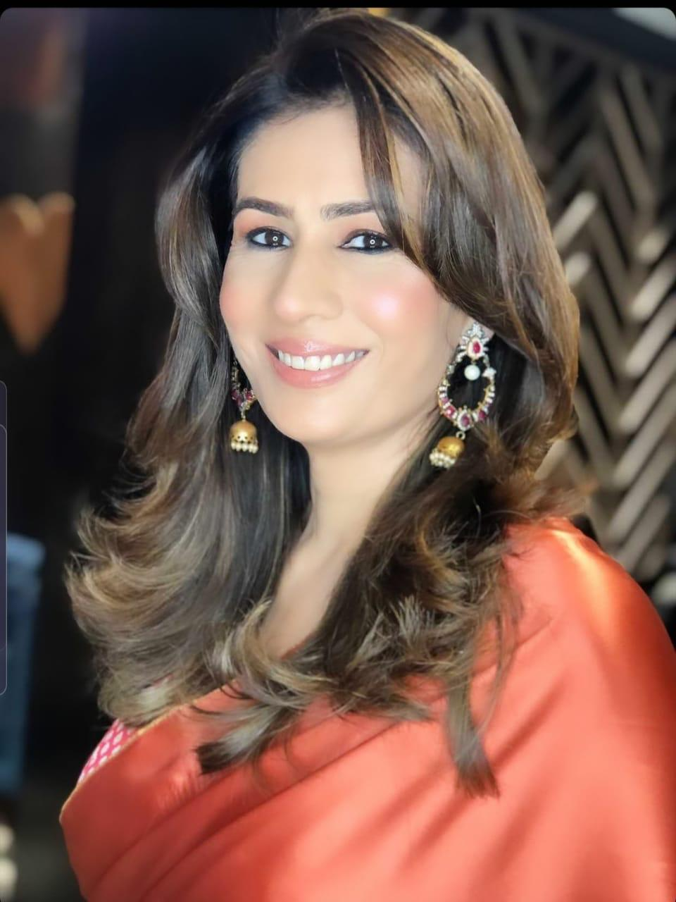
REENA MINHAS , MEMBER Chandigarh UT Diversity & Inclusion Council
BIO :- A soft skills trainer for over a decade she has trained post graduate and specialized courses students . Bagging Miss Punjab and Miss Chandigarh runners up currently she is a full time designer who has her own apparel studio.
Insert High Resolution Picture

Slide 15
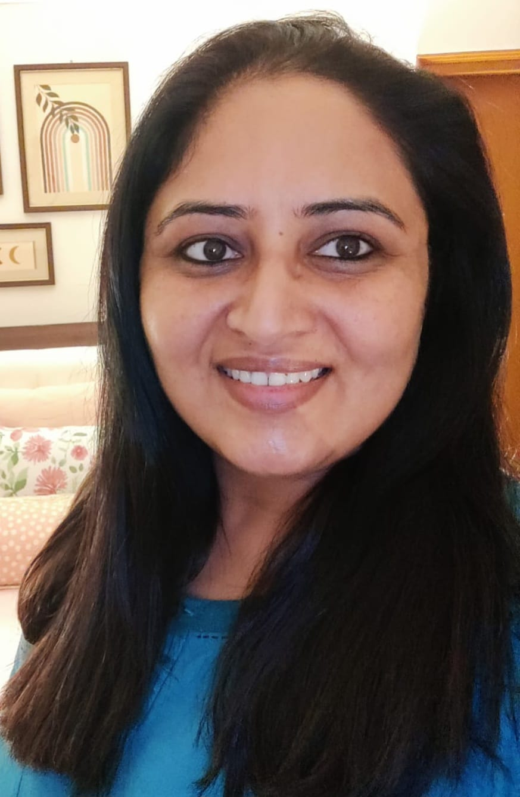
KANWALDEEP KAUR ,MEMBER Chandigarh UT Diversity & Inclusion Council
BIO :- A professional self taught silk painting artist she is currently working on hand painted wearable art and home décor items.
Insert High Resolution Picture

Slide 16
HARPREET JAWANDA , MEMBER Chandigarh UT Diversity & Inclusion Council
BIO :- A qualified high school teacher she has chosen to be a homemaker who enjoys her travels and loves to cook.
Insert High Resolution Picture

Slide 17
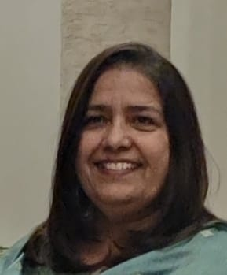
HARPREET DHILLON , MEMBER Chandigarh UT Diversity & Inclusion Council
BIO :- A post graduate in textiles she is into ready to wear clothing which is size inclusive. She loves to travel and explore new places and cultures.
Insert High Resolution Picture

Slide 18
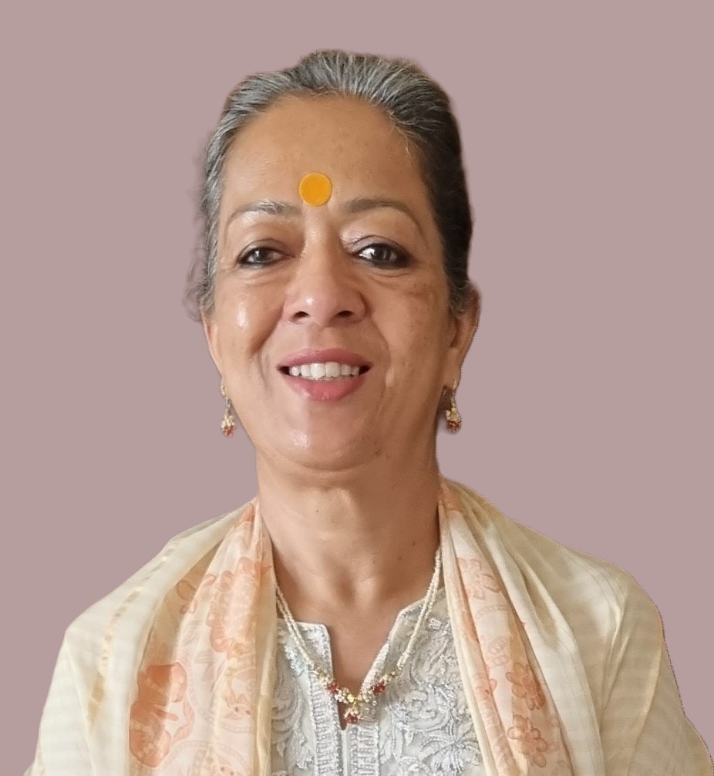
JYOTIE SABHARWAL , MEMBER Chandigarh UT Diversity & Inclusion Council
BIO :- A Botany and Environmental Sciences teacher has conducted many events and youth festivals state wise and nationally. A hockey and theatre enthusiast she loves to write and has edited various articles and content writing assignments.
Insert High Resolution Picture

Slide 19
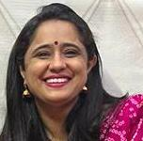
TARANJYOT KAUR ,MEMBER Chandigarh UT Diversity & Inclusion Council
BIO :- Having been a government sector employee and a management graduate she is an art lover and loves to paint on canvas.
Insert High Resolution Picture

Slide 20
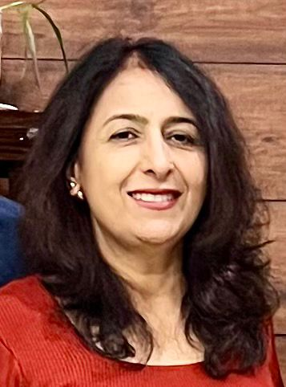
PAVNEET PANNU DHILLON ,MEMBER Chandigarh UT Diversity & Inclusion Council
BIO :- A science graduate she loves to paint in different genres and is a travel and nature freak. Passionate about baking she loves to beautify her home and keep pace with current trends in interior.
Insert High Resolution Picture

Slide 21
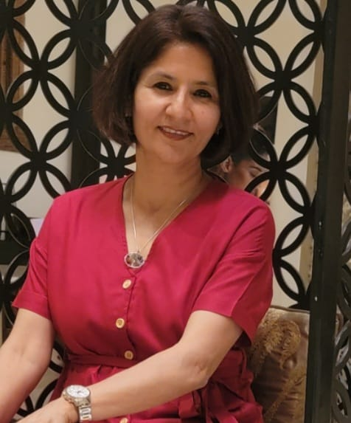
MAJOR(RETD) BALRAJ RANDHAWA,MEMBER Chandigarh UT Diversity & Inclusion Council
BIO :- Having served as an Army Officer for eleven glorious years she has now ventured into sustainable and organic fashion with a contemporary twist.
Insert High Resolution Picture

Slide 22
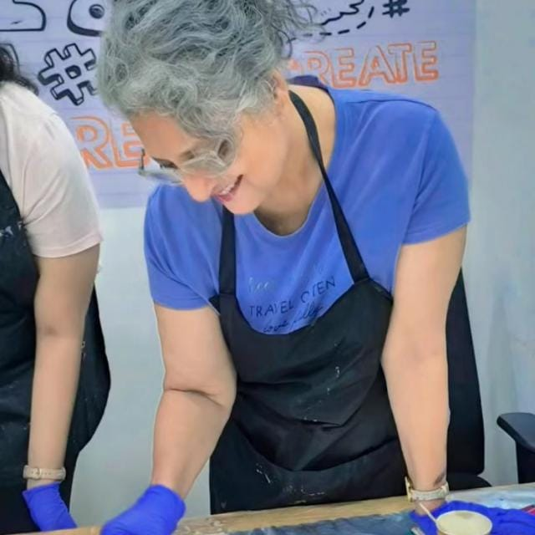
KAMAL NIM ,MEMBER Chandigarh UT Diversity & Inclusion Council
BIO :- A creative person she loves to try her hand at all sorts and mediums of art work.
Insert High Resolution Picture

Slide 23
GAURI PATHAK , MEMBER Chandigarh UT Diversity & Inclusion Council
BIO :- A certified hand writing expert and high school teacher she takes classes for improving handwriting . Baking is her hobby too.
Insert High Resolution Picture

Slide 24
TYPE NAME & WICCI DESIGNATION
COUNCIL MEMBER, (…………. )COUNCIL WICCI
BIO :-
Type Text
Insert High Resolution Picture

Slide 25
TYPE NAME & WICCI DESIGNATION
COUNCIL MEMBER, (…………. )COUNCIL WICCI
BIO :-
Type Text
Insert High Resolution Picture

Slide 26
SUPPORTED BY
WICCI is supported by the massive global networks of ALL Ladies League (ALL), Women Economic Forum (WEF), and SHEconomy.
ALL is a movement of ‘Sisters Beyond Borders.’
WEF is a platform for ‘Business Beyond Borders.’ SHEconomy is e-commerce for women worldwide in Goods & Services for ‘Commerce Beyond Borders’

Slide 27
COUNTRIES REPRESENTED
Albania, Angola, Armenia, Argentina, Australia, Azerbaijan, Bangladesh, Brazil, Burundi, Cameroon, Canada, Chad, China, Costa Rica, Croatia, Cyprus, Czech Republic, Colombia, Ecuador, Egypt, Ghana, Germany, Greece, Guatemala, Hong Kong, Hungary, India, Italy, Israel, Ireland, Japan, Kazakhstan, Kenya, Kyrgyzstan, Lesotho, Luxembourg, Malawi, Malaysia, Mexico, Moldova, Monaco, Montenegro, Morocco, Mozambique, Malta, Netherlands, Nigeria, Nepal, New Zealand, North Macedonia, Norway, Paraguay, Portugal, Peru, Puerto Rico, Philippines, Qatar, Romania, Russia, Rwanda, Serbia, Singapore, Slovenia, Spain, South Africa, South Korea, Suriname, Sweden, Switzerland, Syria, Tunisia, Turkey, Uganda, Ukraine, UK, Uruguay, Venezuela, Vietnam, Virgin Islands (US), UAE, USA, Uzbekistan, Zimbabwe.

Slide 28
WOMEN'S INDIAN CHAMBER OF COMMERCE ANDINDUSTRY

